Slide 1
Project 1: California Standardized Test Analysis
Presented by Stephen Strawbridge
Notes:
Hello everyone, my name is Stephen Strawbridge and I’d like to welcome you all to my presentation on California Standardized Test Analysis
In this presentation, we will dive into some long-held controversies of standardized testing (specifically within the state of California), and present findings using data driven analysis.
Before diving in, lets start with some background facts on standardized testing

Slide 2

SAT/ACT Background
Standardized test = Standardized playing field?
Continuing controversy
Can data provide insight?
Notes:
The SAT and ACT are standardized tests that have stirred controversy for years, and as recently as December of 2019, students and educators commenced a lawsuit over the University of California over its use of standardized tests, claiming these exams were “discriminatory in nature”.
Many Californians claim that access and opportunity to best prepare for the tests is far from equal among the California high school student population and that it is the test administrators responsibility to ensure resources are allocated proportionally to ensure more equal opportunity.
So where do we go from here?

Slide 3

Problem Statement
First: Where are underperforming students according to the following demographics:
County
Race
Parental income level
Then: Where to allocate resources as necessary to ensure a more equal representation of successful standardized test takers.
Notes:
Read slide
In the following slides, data according to these 3 demographics are presented

Slide 4
Analysis by County – SAT and ACT
Lowest participating counties:
Modoc
Sierra
Trinity
Notes:
In terms of numbers on average, the counties of Modoc, Sierra, and Trinity had the lowest SAT participation for both 11th and 12th grades. 11th grade participation ranged from about 10 to 30 students, while 12th grade participation ranged from about 5 to 10 students. Even considering the fact that these counties may have a smaller population size, these stats were far below the average of all schools, where the 11th grade and 12th grade means were about 119 students and 100 students, respectively.
In order to proportionally scale these findings, the percentage for each county was taken and similar results were found.
One key takeaway from these findings is that fact that nearly all of the highly urbanized areas of California were excluded from these bottom 10 ranks.
In comparison, nearly all of the counties present in the findings above were located in more rural areas.
With this data, can we conclude that rural counties on average participate less and perform worse than urban counties?

Slide 5
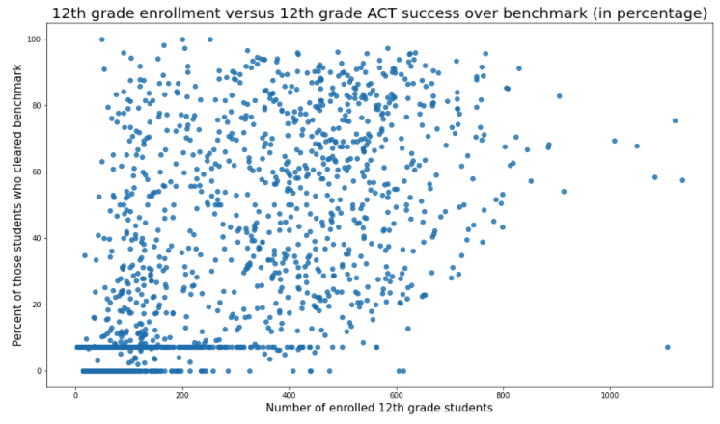
Analysis by County - ACT
Correlation =
63%
More factors to consider?
Notes:
It turns out, there are more significant factors at play
Rural areas (with smaller number of enrolled students) only has a slight correlation to the success rate of standardized test takers.
In the correlation chart above, we now observe the ACT, which shows a correlation of 63% between number of enrolled students and percent of those students who cleared the college board benchmark.
Therefore, rural areas generally may perform under the average, but a deeper dive into the demographics of these counties is needed.

Slide 6
Analysis by Income
Score
Notes:
According to the National Center for Education Statistics (NCES), in their data pulled from 2012, family income and highest level of parental education were directly correlated with student scores.
This finding was consistent among all 3 subjects of the SAT (reading, math, and writing).
In every income bracket given, the higher the family income, the higher the student’s score was on average.
This may not be a surprise to most of you, as standardized test preparation can be very costly.

Slide 7
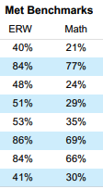
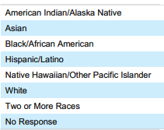
Analysis by Race
SAT 2020 Performance by Race
Lowest performing :
American Indian
Black/African American
Hispanic/Latino
Source: https://reports.collegeboard.org/pdf/2020-california-sat-suite-assessments-annual-report.pdf
Notes:
According to the 2020 SAT College board annual report, Asian and White students scored the highest, with a mean score for Asian students at 1207 and a mean score for White students at 1158.
To provide perspective, these “benchmarks” are set numerical standards across all schools each year by the SAT administration.
The lowest performing demographics were American Indian, African American students, and Hispanic with mean scores of 917 and 938, respectively.
Interestingly, the low participating/performing rural areas given in the previous slides are mostly comprised of White and Hispanic students. This finding seems to suggest that the urban areas may perform higher on average, but fluctuate much higher depending on the income or racial demographic within that urban area.

Slide 8

Summary and Recommendations
Key takeaway: School size within county has a slightly, but not strong, correlation to performance
Perhaps more factors are: Income/racial demographics within each county
Recommendation:
Rural areas: allocate funding to where test participation is lower
Urban areas: allocate funding not per location/county, but rather income/racial demographics
Notes:
(Read key takeaway and second bullet point)
After diving deeper into more specific demographics from outside research, it is apparent that many other factors must be taken into consideration. For example, urban counties such as Los Angeles, have a high student population but may have a very fluctuating range of low and high performing students within the county.
(Read recommendation bullet point)

Slide 9
Thank you for your time!
Questions?

Slide 10
Sources
NBC News: (https://www.nbcnews.com/news/education/california-lawsuit-blasts-sat-act-exams-discriminatory-n1099416)
Prep Scholar Blog: (https://blog.prepscholar.com/how-much-do-sat-prep-courses-cost)
2020 SAT College Board Annual Report: (https://reports.collegeboard.org/pdf/2020-california-sat-suite-assessments-annual-report.pdf)
NCES: (https://nces.ed.gov/programs/digest/d12/tables/dt12_173.asp)

